Slide 1
Pattern Recognition
mini project
Speaker : M10517035

Slide 2
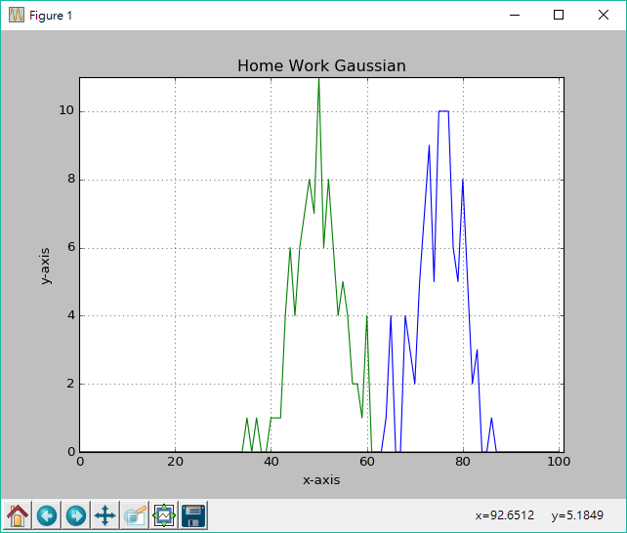
Example 1 : D=100,N=100
Theta : 0.5
Theta : 0.25
TP 7500
TN 2465
FP 35
FN 0
TP 4999
TN 5000
FP 0
FN 1

Slide 3
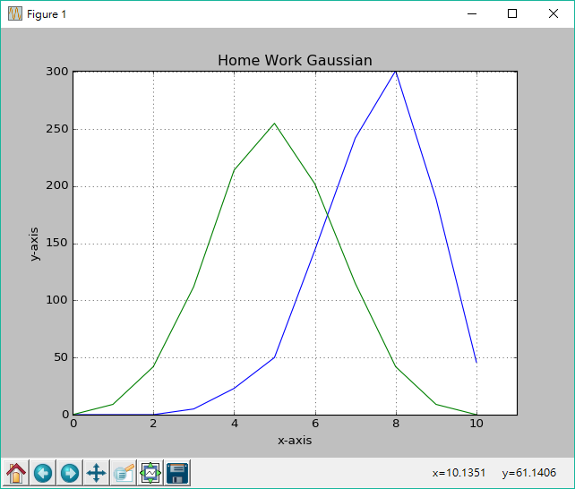
Example 10: D=10,N=1000
Theta : 0.5
Theta : 0.25
TP 4994
TN 5000
FP 0
FN 6
TP 7484
TN 2500
FP 0
FN 16

Slide 4
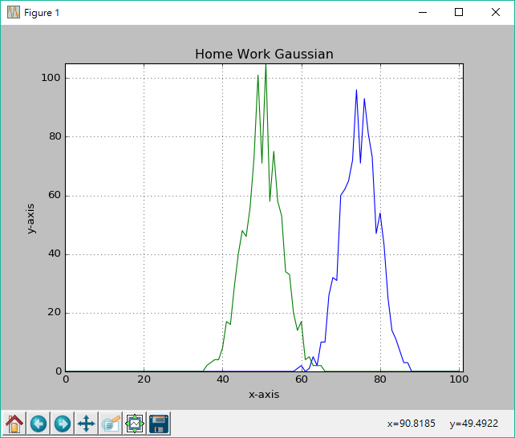
Example 1 : D=100,N=1000
Theta : 0.5
Theta : 0.25
TP 50000
TN 49780
FP 220
FN 0
TP 74783
TN 25000
FP 0
FN 217

Slide 5
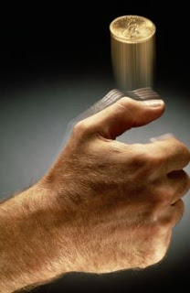

class diagram

Slide 6
Objective
Y
35
25
25
8
7
[100]
[10]
[20]
[30]
[40]
[50]
X

Slide 7
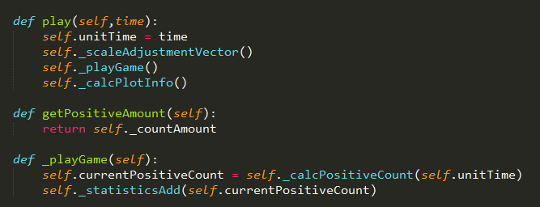
Code

Slide 8
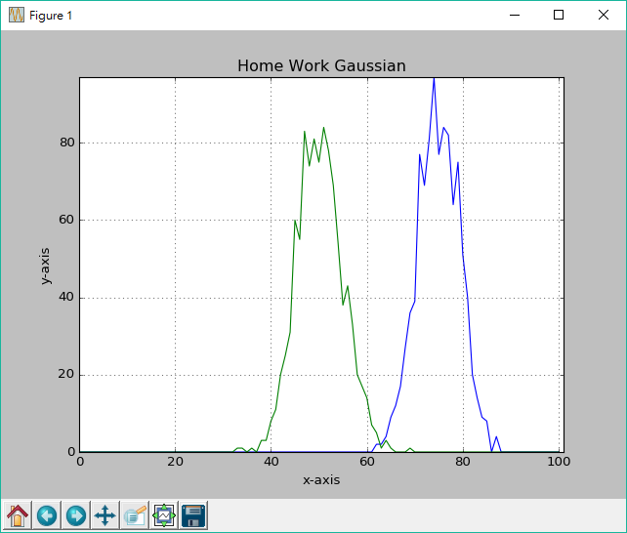
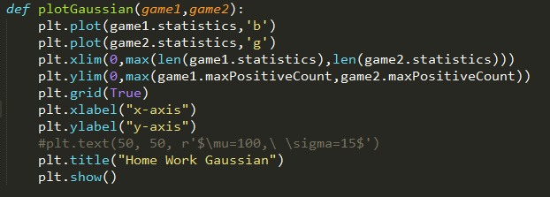
Code

